Slide 1
Welcome to the Pro Bono Consulting Practice!
Instructions for Submitting Requested Information
Notes:
Welcome the Federation’s Pro Bono Consulting practice! This presentation will lead you through the process to apply and track your pro bono project. As the Pro Bono Consulting practice is a new program, while in this Beta mode, we are utilizing the Grants Management system to track pro bono projects. It is a bit clunky, but we hope this set of instructions will clarify the steps required for the system.

Slide 2
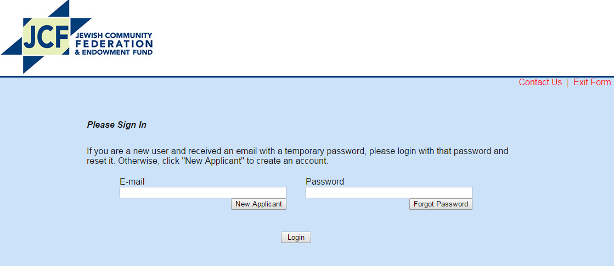
Establishing your account
First-time users will have received a temporary password in an email from: grantsmanagement@sfjcf.org
Use that password to login & reset your password here: https//grantrequest.com/SID_364/

Slide 3
Establishing your account
If you cannot find the email with your temporary password, then go here: https//grantrequest.com/SID_364/
Click: “Forgot Password.”
You will receive instructions for creating a user account.

Slide 4
Managing Your Account
After you login to your new account, you will see this screen:
Click on “Reports” to see the specific information that is requested of you.

Slide 5
In the Reports Tab, on the far right, is a drop down screen with:
New Requirements
In Progress Requirements
Submitted Requirements
Select one, then click on the highlighted item under “Form Name” to fill out and submit the requested information.
Still need help? Email: jcfprobono@sfjcf.org

